Slide 1
Before Tutorial Starts
Tutorial Page
https://pegasus.isi.edu/tutorial/usc
Logon to hpc-pegasus.usc.edu using your USC Netid
e.g. ssh vahi@hpc-pegasus.usc.edu
It will prompt for a password
Notes:
Direct link: http://download.pegasus.isi.edu/wms/download/4.3/PegasusTutorialVM-4.3.0.zip

Slide 2
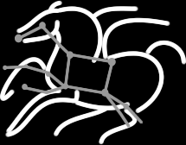
Scientific Workflows through Pegasus WMS at USC HPC Cluster
Karan Vahi, Mats Rynge
Science Automation Technologies Group
USC Information Sciences Institute

Slide 3
Agenda
2:00 – 2:30 Introduction on Workflows and Pegasus
2:30 – 3:30 Hands on Exercises
3:30 – 4:30 Features addressing user problems
4:30 – 5:00 Discussion

Slide 4
Scientific Workflows
Orchestrate complex, multi-stage scientific computations
Often expressed as directed acyclic graphs (DAGs)
Capture analysis pipelines for sharing and reuse
Can execute in parallel on distributed resources
Setup
Split
Filter & Convert
Map
Merge
Analyze
Epigenomics Workflow
Notes:
Expressed in high-level workflow languages

Slide 5
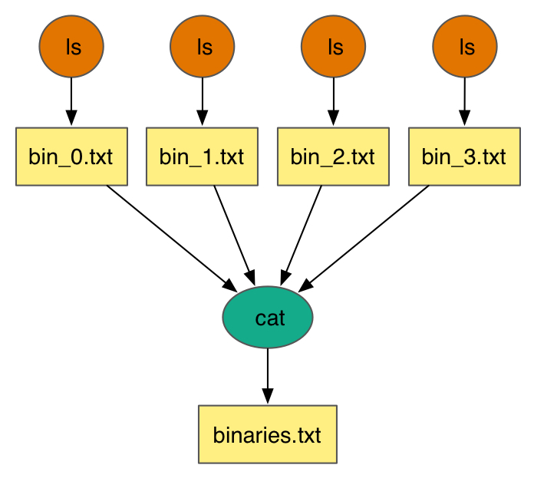
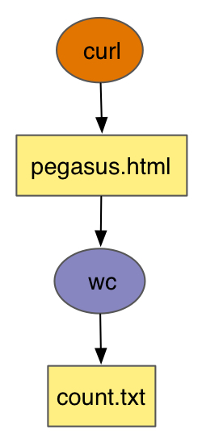
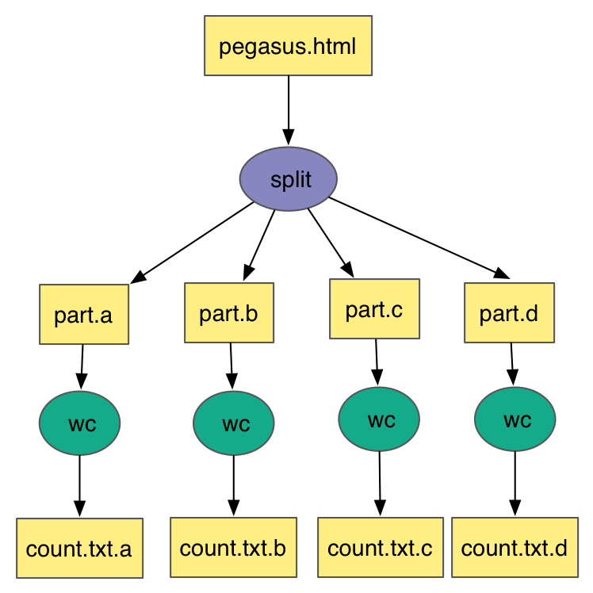
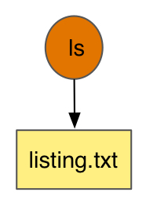
Simple Workflows – Building Blocks
Notes:
Simple Workflow constructs that serve as building workflows for more complex examples

Slide 6
Complex RNA-Sequencing Workflow - GTFAR

Slide 7
Challenges while Executing Compute Pipelines
Portability
How can you run a pipeline on Amazon EC2 one day, and a PBS cluster the next?
Data Management
How do you ship in the small/large amounts data required by your pipeline?
Different protocols for different sites: Can I use SRM? How about GridFTP? HTTP and Squid proxies?
Can I use Cloud based storage like S3 on EC2?
Debug and Monitor Computations.
Users need automated tools to go through the log files
Need to correlate data across lots of log files
Need to know what host a job ran on and how it was invoked
Restructure Pipelines for Improved Performance
Short running tasks?
Data placement?

Slide 8
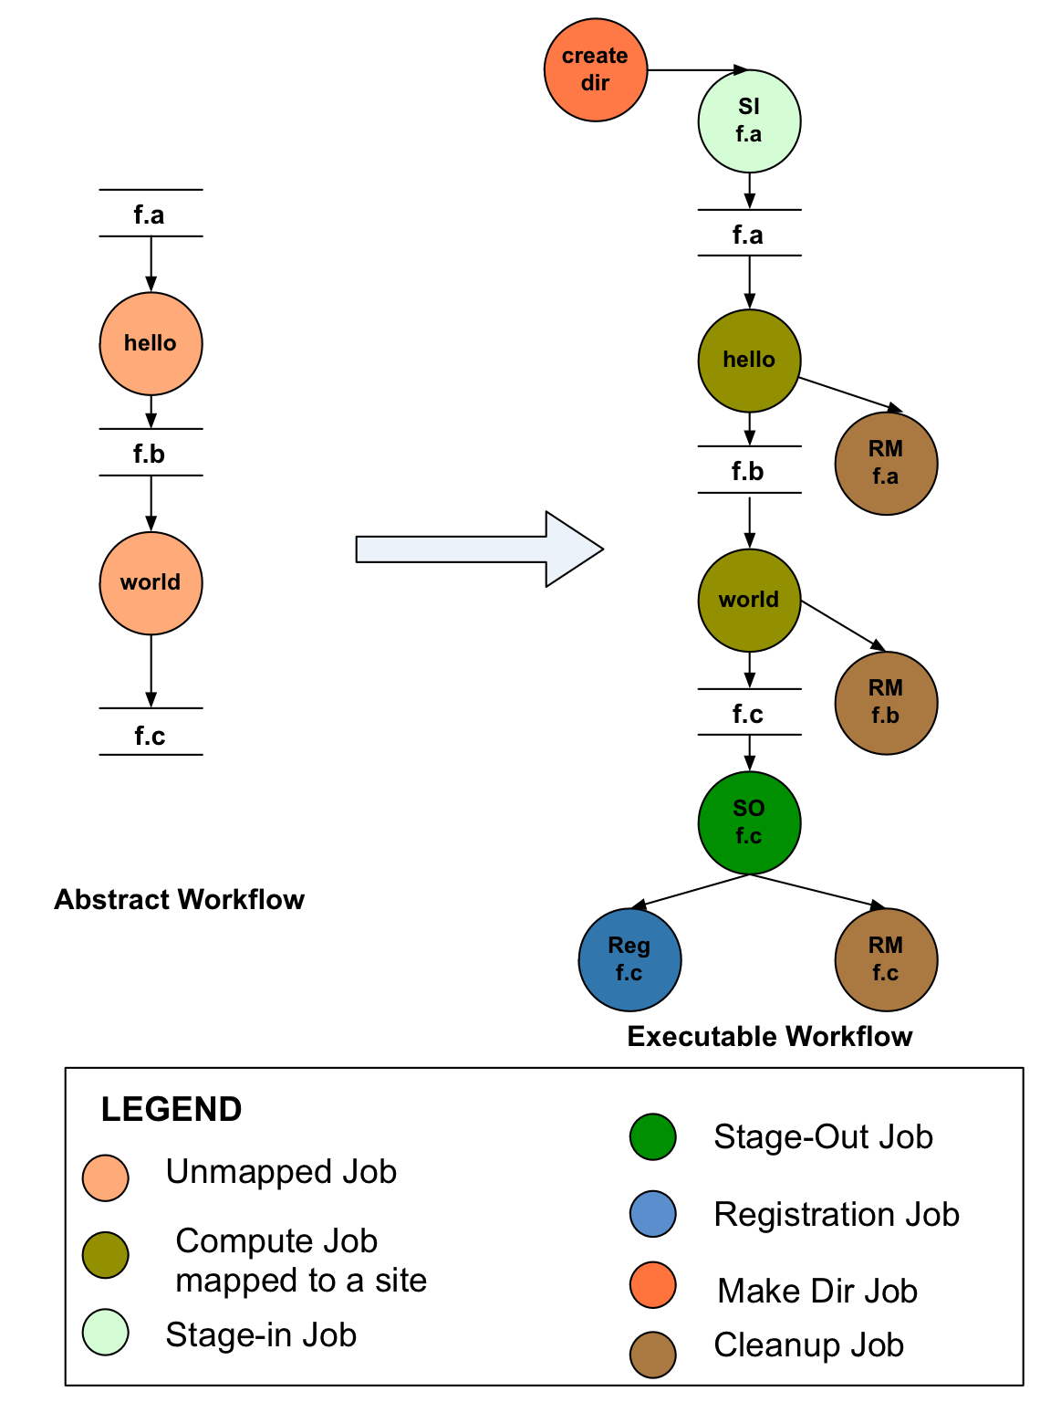
Pegasus Workflow Management System
NSF funded project since 2001
Developed as a collaboration between USC Information Sciences Institute and the HTCondor Team at UW Madison
Builds on top of HTCondor DAGMan.
Abstract Workflows - Pegasus input workflow description
Workflow “high-level language”
Only identifies the computation, devoid of resource
descriptions, devoid of data locations
File Aware – For each task you specify the input and
output files
Pegasus is a workflow “compiler” (plan/map)
Target is DAGMan DAGs and Condor submit files
Transforms the workflow for performance and reliability
Automatically locates physical locations for both workflow components and data
Collects runtime provenance

Slide 9
Pegasus Workflow Management System (est. 2001)
Maps a resource-independent “abstract” workflow onto resources and executes the “executable” workflow
Benefits
Automation
Automates complex, multi-stage processing pipelines
Enables parallel, distributed computations
Automatically executes data transfers
Reusable portable description of workflows that
aids reproducibility
Recovery
Automatic job retries
Ability to restart pipelines without repeating steps
Debug
Records how data was produced (provenance)
Simple easy to use command line tools for monitoring and debugging
Web Based Dashboard Available

Slide 10
Pegasus Deployment

Slide 11
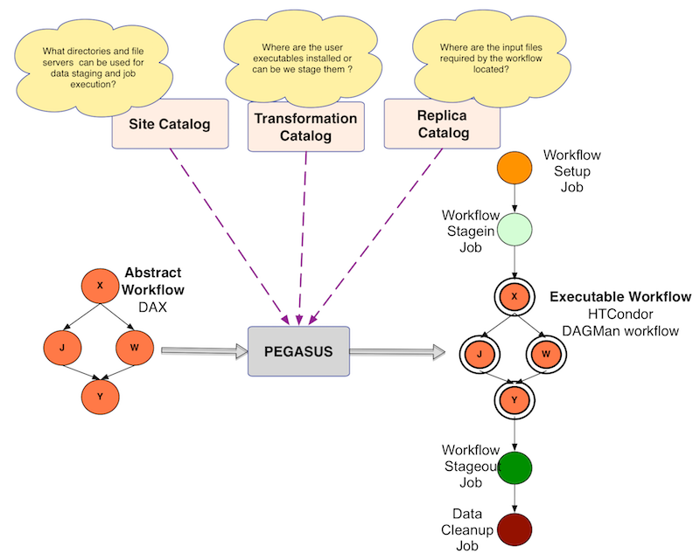
Abstract to Executable Workflow Mapping - Discovery

Slide 12
Simple Steps to Run Pegasus
Specify your computation in terms of DAX
Write a simple DAX generator
Python, Java , Perl based API provided with Pegasus
Set up your catalogs
Replica catalog, transformation catalog and site catalog.
Plan and Submit your workflow
Use pegasus-plan to generate your executable workflow that is mapped onto the target resources and submits it for execution
Monitor and Analyze your workflow
Use pegasus-status | pegasus-analyzer to monitor the execution of your workflow
Workflow Statistics
Run pegasus-statistics to generate statistics about your workflow run.

Slide 13
Move to Hands on Tutorial

Slide 14
Agenda
2:00 – 2:30 Introduction and Tutorial on Pegasus
2:30 – 3:30 Hands on Exercises
3:30 – 4:30 Features addressing user problems
4:30 – 5:00 Discussion

Slide 15
Hands on Tutorial Outline
Topics Covered
What are Scientific Workflows (already done)
Submission of an already generated example workflow with Pegasus.
How to use the Pegasus Workflow Dashboard for monitoring workflows.
Command line tools for monitoring, debugging and generating statistics.
Recovery from failures
Creation of workflow using system provided API
Information catalogs configuration
Running the whole workflow as a MPI job

Slide 16
Agenda
2:00 – 2:30 Introductions on Workflows and Pegasus
2:30 – 3:30 Hands on Exercises
3:30 – 4:30 Features addressing user problems
4:30 – 5:00 Discussion

Slide 17
Failure Recovery

Slide 18
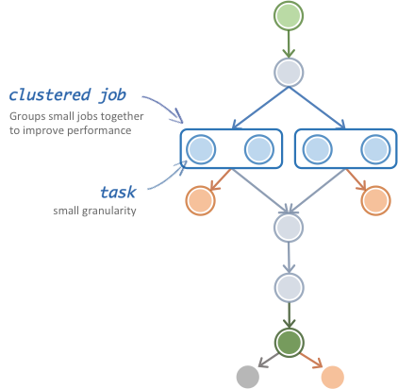
Task Clustering
Cluster small running jobs together to achieve better performance
Why?
Each job has scheduling overhead – need to make this overhead worthwhile
Ideally users should run a jobs that take at least 10/30/60/? minutes
Clustered tasks can reuse common input data – less data transfers

Slide 19
Fine-Grained Workflows
Problem: Many scientific workflows are fine-grained
Thousands of tasks
Short duration
Serial
Collectively, these tasks require distributed resources to finish in a reasonable time, but individually they are relatively small
Touch many GB or TB of data
Consume thousands of CPU hours
Many large-scale compute resources are optimized for a few, large, parallel jobs, not many small, serial jobs
Serial tasks face long queue times due to low priority
Batch schedulers have low throughput
Results in poor workflow performance

Slide 20
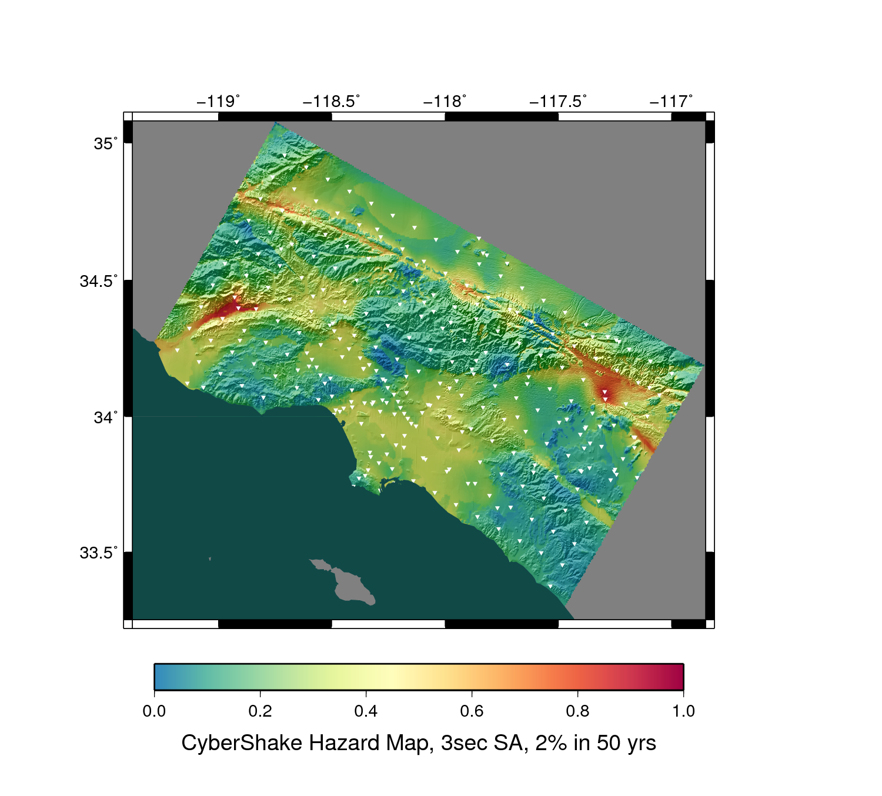
Fine Grained Workflows
CyberShake PSHA Workflow
Builders ask seismologists: “What will the peak ground motion be at my new building in the next 50 years?”
Seismologists answer this question using Probabilistic Seismic Hazard Analysis (PSHA)
2014: 286 Sites, 4 models
Each site = one workflow
Each workflow has 420,000 tasks in 21 jobs

Slide 21
Fine Grained Workflows
Solution: Pegasus-MPI-Cluster
A master/worker task scheduler for running fine-grained workflows on batch systems
Runs as an MPI job
Uses MPI to implement master/worker protocol
Allows sub-graphs of a Pegasus workflow to be submitted as monolithic jobs to remote resources

Slide 22

Connecting Pipelines
Problem
For large scale analysis, scientists often want to compose larger constructs from smaller working pipelines.
Groups from the same domain collaborate and want to connect pipelines as part of larger analysis
Also want to scale to workflows with millions of tasks in total.
Example Application Use Case - Montage Galactic Plane Workflow
Existing montage workflow that can generate 5 degree mosiacs
18 million input images (~2.5 TB)
900 output images (2.5 GB each, 2.4 TB total)
10.5 million tasks (34,000 CPU hours)
× 17
Notes:
Kent changed 080501 – removed period

Slide 23
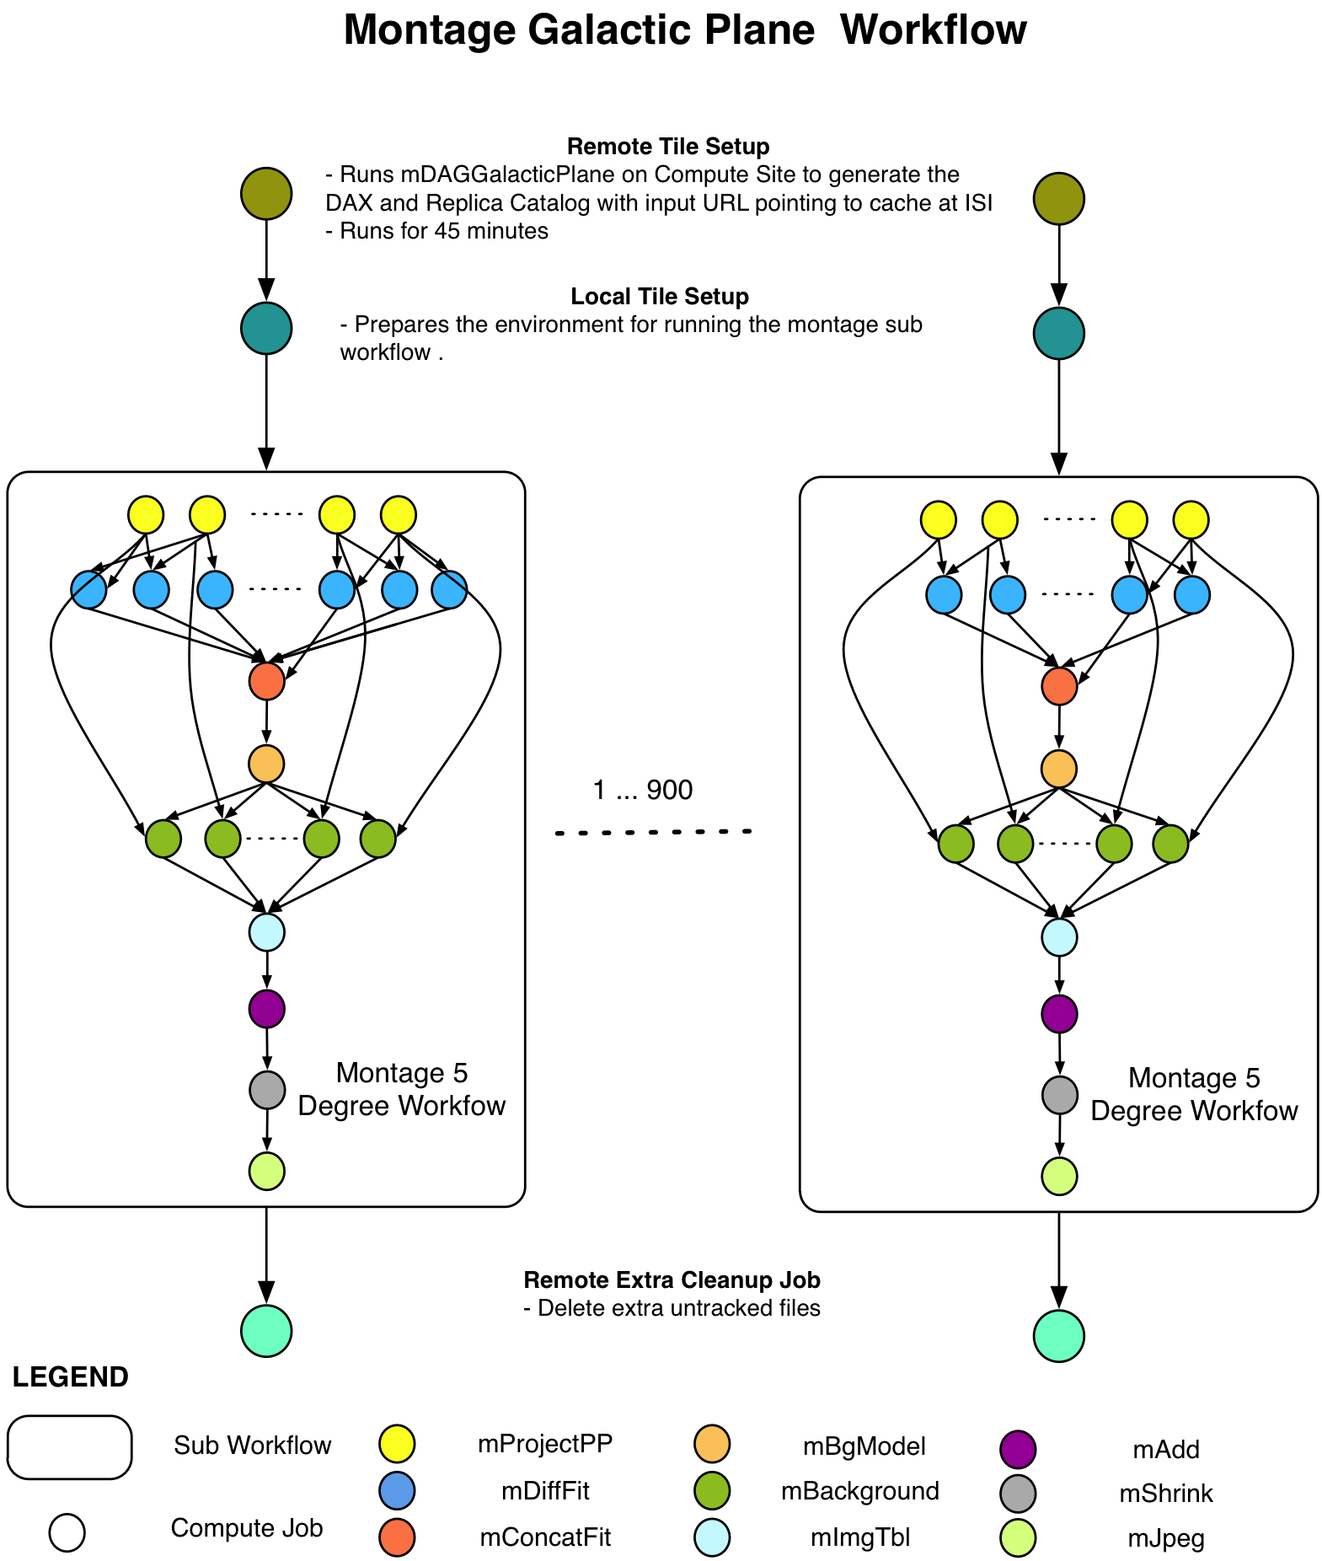
Connecting Pipelines
Solution
Pegasus allows jobs/nodes in a workflow to refer to other workflows, allowing users to connect distinct workflows for analysis.
Updated our debugging tools to handle these workflow of workflows.
Notes:
Kent changed 080501 – removed period

Slide 24
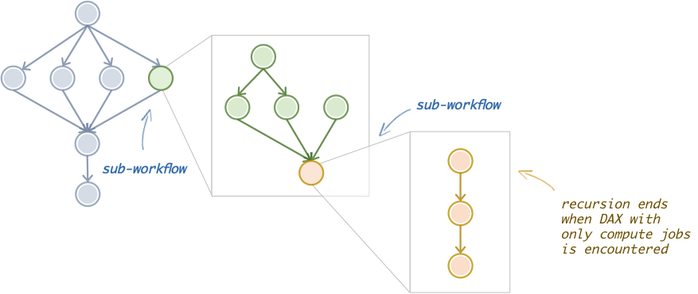
Hierarchical Workflows

Slide 25
Reusing Data Products
Problem
Users want to be able to intelligently reuse previously generated outputs.
Genomic Workflows want to avoid index generation steps for raw input files
Long running analysis fail, and users realize they need to regenerate workflow description, as wrong arguments set or missing jobs.
Notes:
Kent changed 080501 – removed period

Slide 26
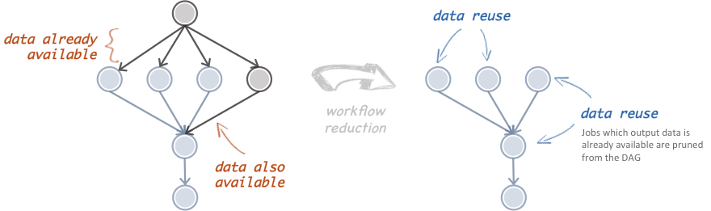
Reusing Data Products
Solution: Workflow Reduction
Don’t execute jobs at runtime for which data products already exist.
Similar to make style semantics for compiling code
Notes:
Sometimes it is cheaper to access the data than to regenerate it
Keeping track of data as it is generated supports workflow-level checkpointing
Kent changed 080501 – added period

Slide 27
File cleanup
Problem
Users run out out of disk space during workflow execution
Why does it occur
Workflows could bring in huge amounts of data
Data is generated during workflow execution
Users don’t worry about cleaning up after they are done
Example Application
SoyKB workflows from iPlant
Epigenomics Pipelines generating 60TB of data in a single execution
Notes:
Kent changed 080501

Slide 28
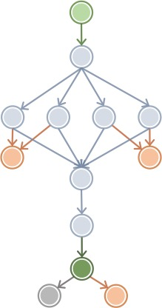

File cleanup
Solution
Do cleanup after workflows finish
Does not work as the scratch may get filled much before during execution
Interleave cleanup automatically during workflow execution.
Requires an analysis of the workflow to determine, when a file is no longer required
Cluster the cleanup jobs by level for large workflows
Too many cleanup jobs adversaly affect the walltime of the workflow.
cleanup job
Notes:
Kent changed 080501

Slide 29
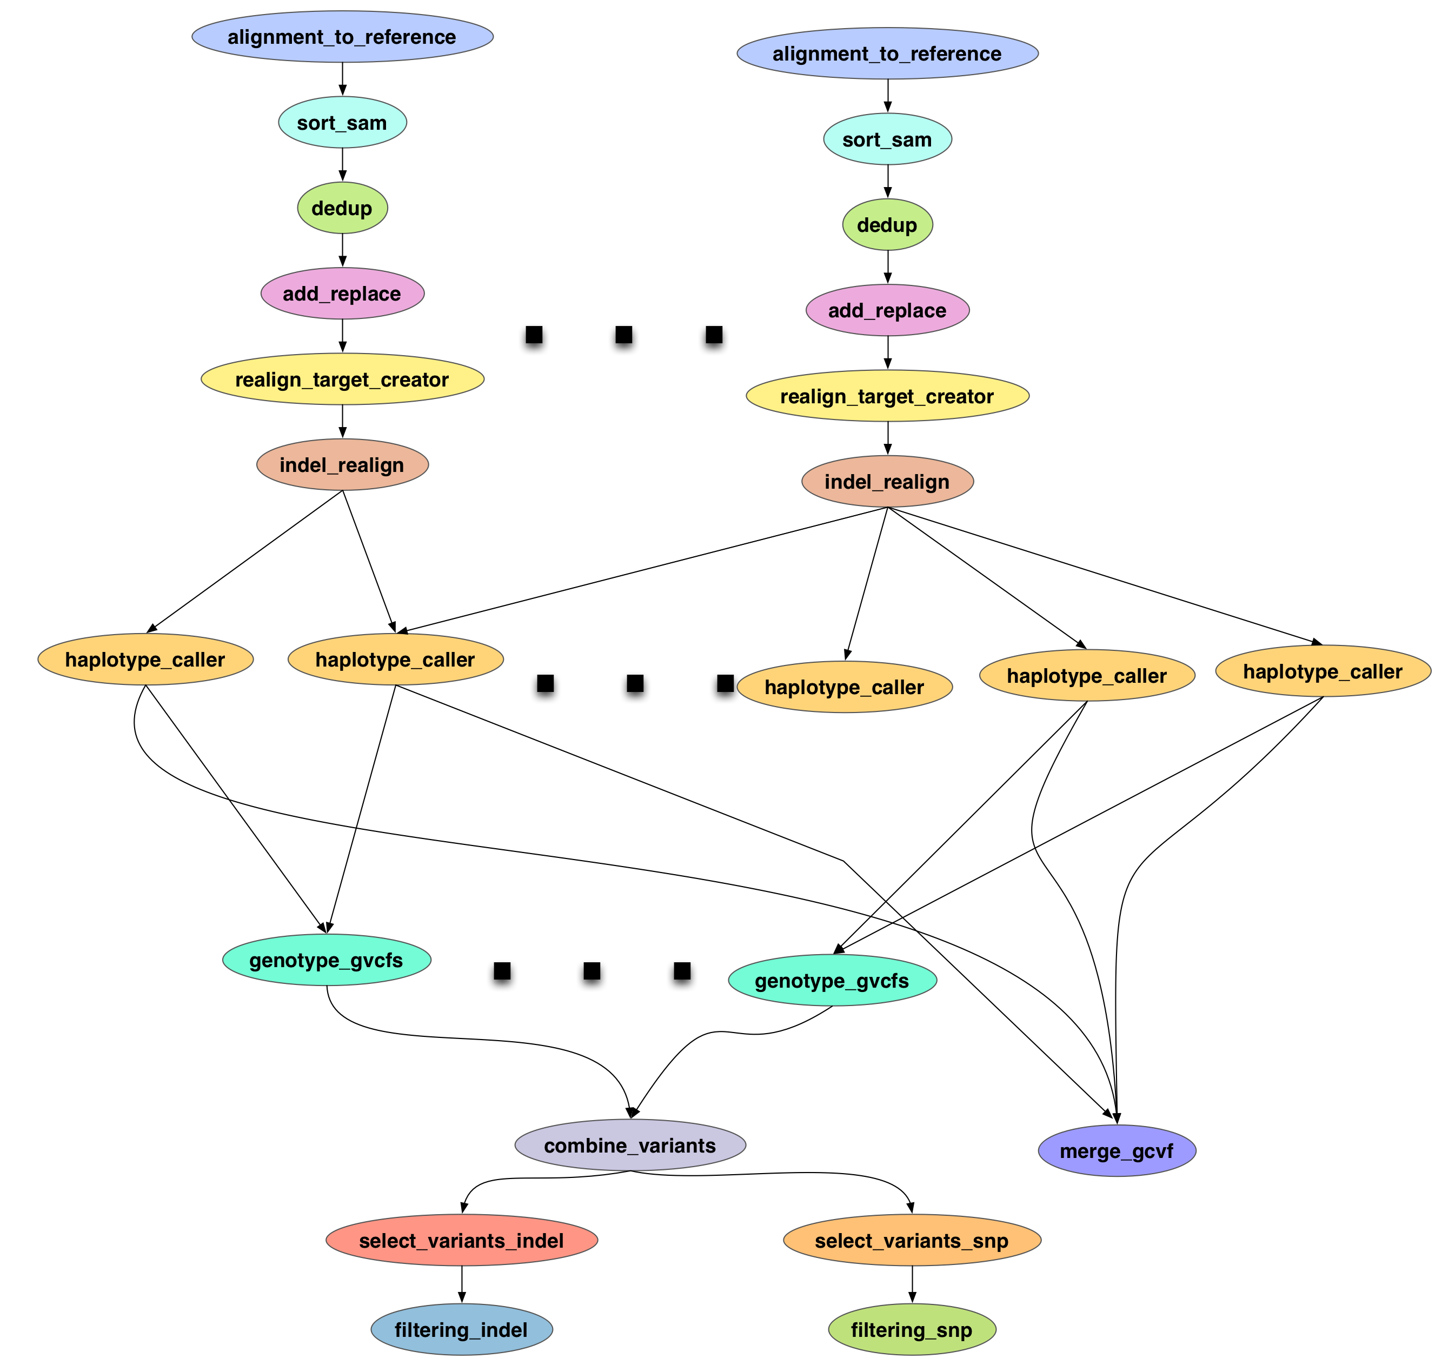
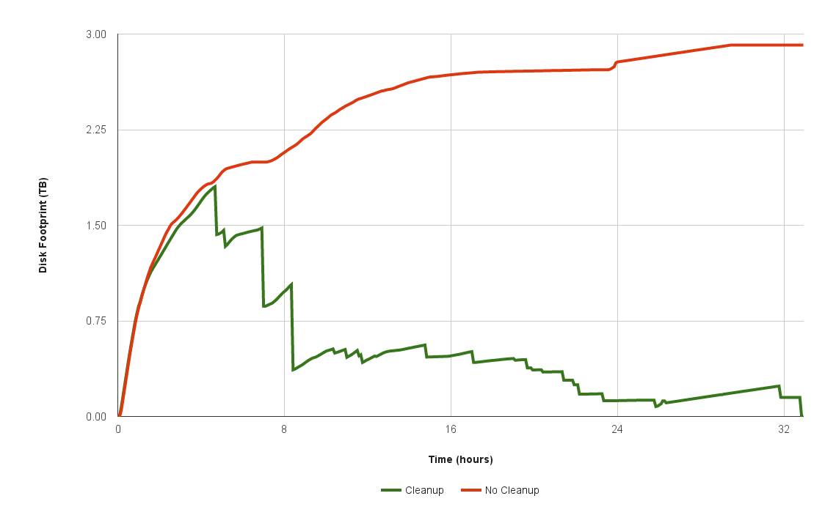
File cleanup (cont)
Single SoyKB NGS Pegasus
Workflow with 10 input reads.
Notes:
The attached graph shows two Pegasus runs for the SoyKB workflow with 10 input reads. A typical production workflow is about 4 times larger. One run is with inplace cleanup and one without cleanup
Without inplace cleanup
{
"data_config": "sharedfs",
"wf_metrics": {
"compute_tasks": 290,
"total_tasks": 290,
"dax_input_files": 23,
"dax_inter_files": 550,
"dax_output_files": 7,
"dax_total_files": 580,
"compute_jobs": 290,
"si_tx_jobs": 40,
"so_tx_jobs": 48,
"reg_jobs": 155,
"cleanup_jobs": 1,
"create_dir_jobs": 1,
"chmod_jobs": 18,
"total_jobs": 553
},
"app_metrics": {
"name": "Soykb"
}
}

Slide 30
What Does Pegasus provide an Application - I
Portability / Reuse
User created workflows can easily be mapped to and run in different environments without alteration.
Data Management
Pegasus handles replica selection, data transfers and output registrations in data catalogs. These tasks are added to a workflow as auxiliary jobs by the Pegasus planner.
Performance
The Pegasus mapper can reorder, group, and prioritize tasks in order to increase the overall workflow performance.
Notes:
Kent changed 080501 – removed period

Slide 31
What Does Pegasus provide an Application - II
Provenance
Provenance data is collected in a database, and the data can be summaries with tools such as pegasus-statistics, pegasus-plots, or directly with SQL queries.
Reliability and Debugging Tools
Jobs and data transfers are automatically retried in case of failures. Debugging tools such as pegasus-analyzer helps the user to debug the workflow in case of non-recoverable failures.
Scalability
Hierarchal workflows
Scale to hundreds of thousands of nodes in a workflow.
Notes:
Kent changed 080501 – removed period

Slide 32
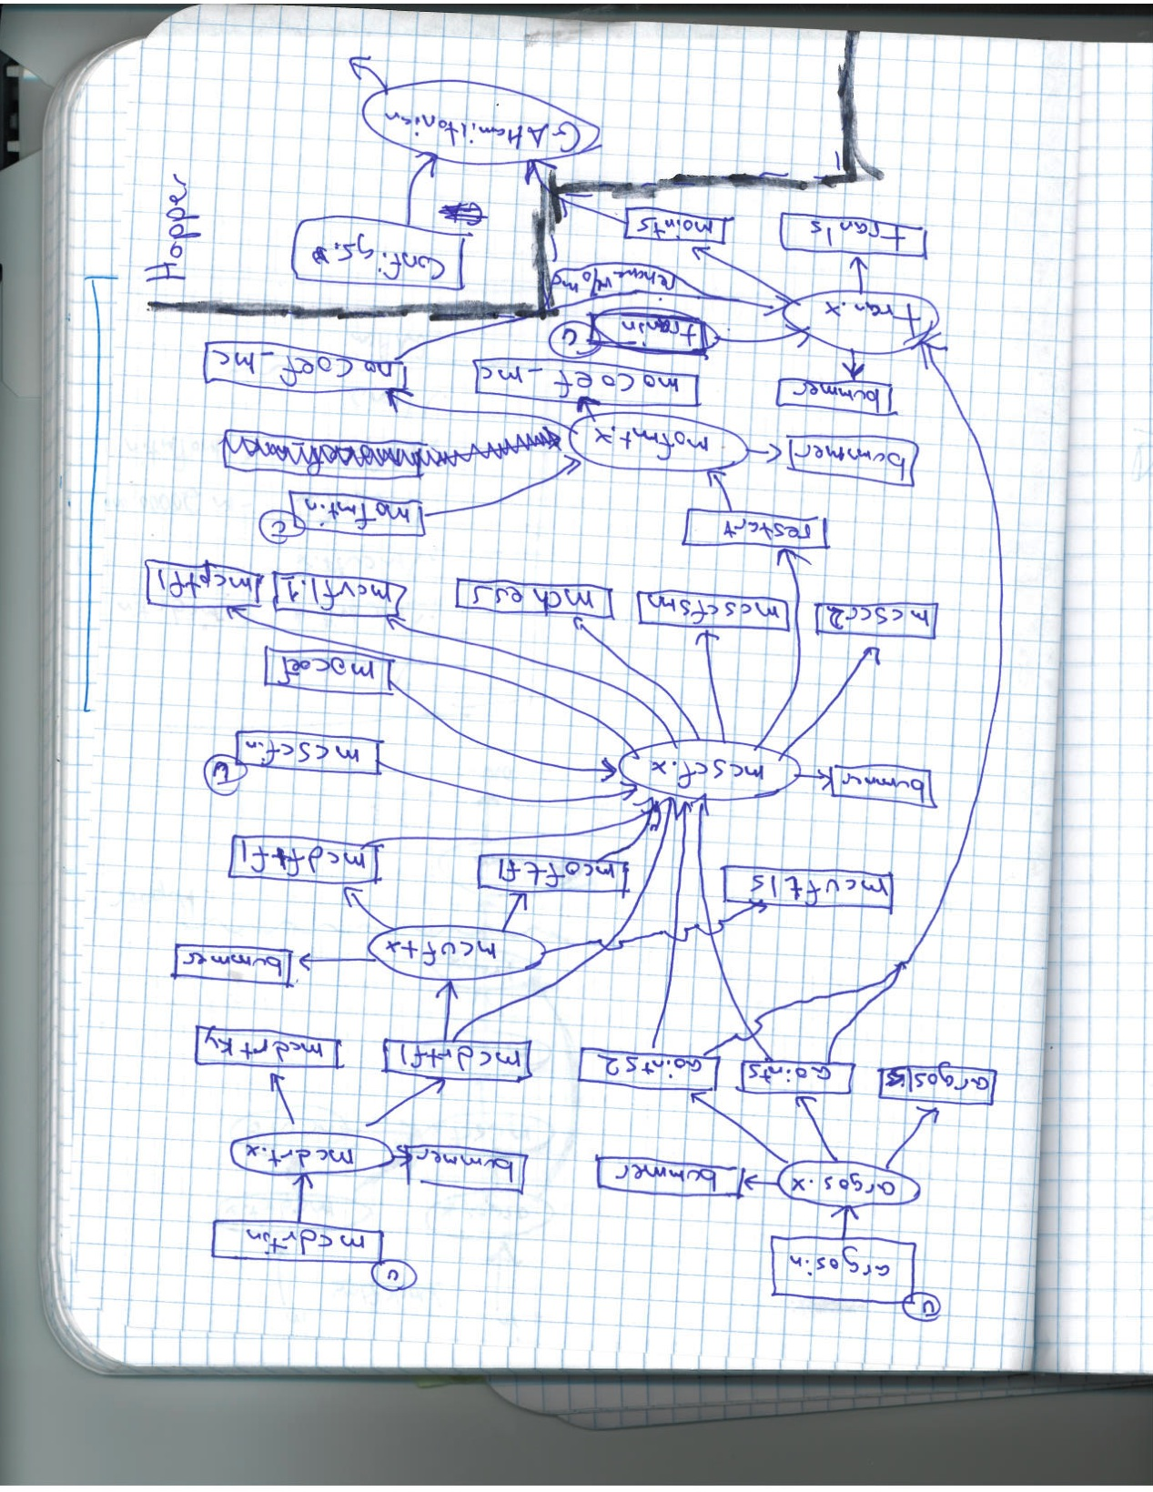
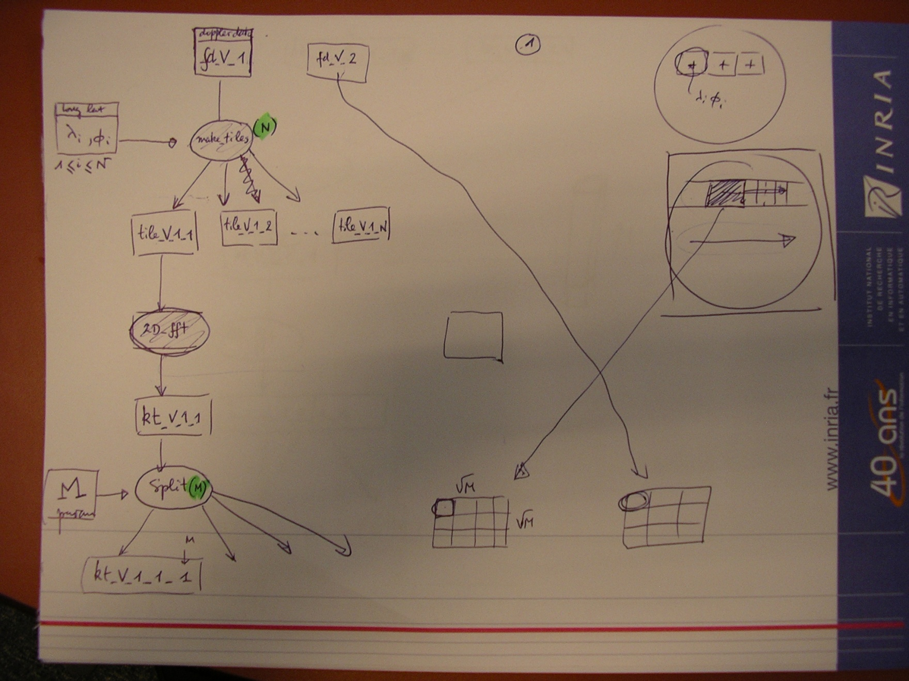
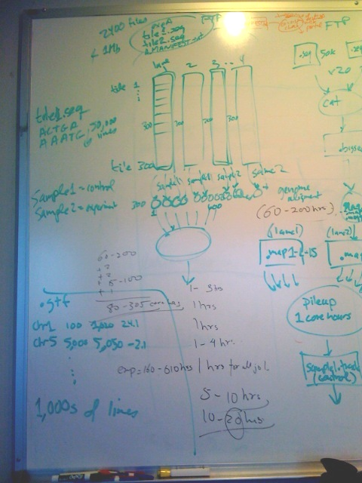
If you get stuck…
And you can draw….
We can help you!

Slide 33
Pegasus
est. 2001
Automate, recover, and debug scientific computations.
Pegasus Website
http://pegasus.isi.edu
Get Started
Users Mailing List
pegasus-users@isi.edu
Support
HipChat
pegasus-support@isi.edu

Slide 34

Pegasus
est. 2001
Meet our team
Automate, recover, and debug scientific computations.
Ewa Deelman
Thank You
Karan Vahi
Gideon Juve
Questions?
Mats Rynge
Rajiv Mayani
Rafael Ferreira da Silva

